Slide 1

Practical 10
Function to Check if a Binary Tree is a Valid BST

Slide 2

Lesson Plan
Subject/Course | Competitive Coding
Lesson Title | Function to Check if a Binary Tree is a Valid BST
Lesson Objectives
Understand the concept and properties of a Binary Search Tree (BST).
Learn how to validate whether a given binary tree is a valid BST.
Implement BST validation using recursion and range checking.
Analyze the time and space complexity of the BST validation algorithm.

Slide 3
Problem Statement
Write a program to check whether a given Binary Tree is a Valid Binary Search Tree (BST) or not.
Conditions:
1. Each node’s left subtree must contain values less than the node’s key.
2. Each node’s right subtree must contain values greater than the node’s key.
3. Both left and right subtrees must themselves be valid BSTs.

Slide 4
Concept
A Binary Search Tree (BST) is a special kind of binary tree that maintains sorted order.
1. Property: left < root < right
2. The inorder traversal of a BST produces a sorted sequence.
3. To verify a binary tree, this property must hold recursively for every node.

Slide 5
Algorithm/Logic
Approach 1 – Recursive Range Check:
Start from the root node.
Define valid range (min, max) for each node.
Check if node value lies within range.
Recursively verify both subtrees.
Left subtree uses range (min, node.data)
Right subtree uses range (node.data, max)
If all nodes satisfy the condition, the tree is a valid BST.

Slide 6
Algorithm/Logic
Approach 2 – Inorder Traversal Check:
Perform inorder traversal and track previous node.
If current node ≤ previous node → Not a BST.
If traversal is sorted → Valid BST.
This method also runs in O(n) time.

Slide 7
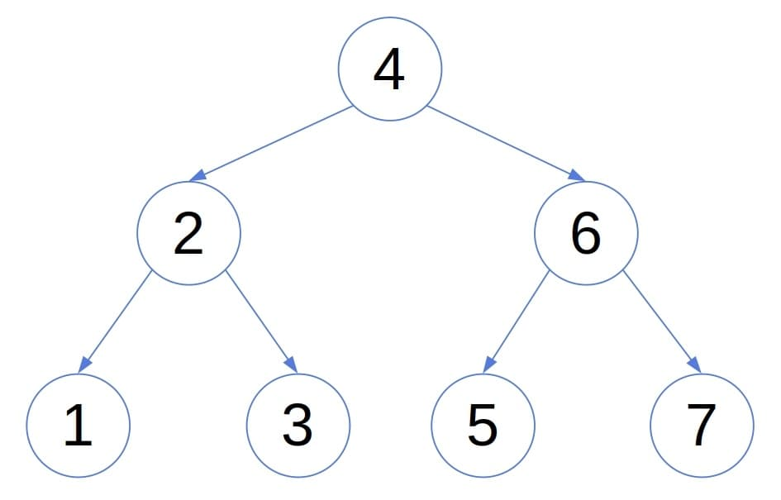
Visualization
Inorder Traversal: 1,2,3,4,5,6,7
Result: Valid BST

Slide 8
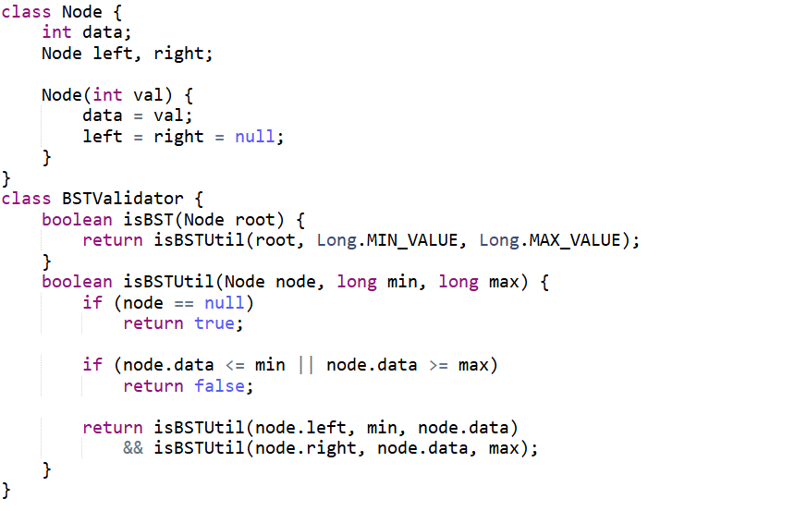
Code Implementation

Slide 9
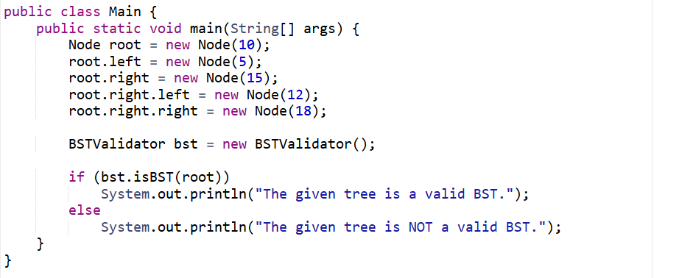

Slide 10

Output

Slide 11
Example Walkthrough
1. Root (10): range (−∞, +∞) → OK
2. Left (5): range (−∞, 10) → OK
3. Right (15): range (10, +∞) → OK
4. All nodes satisfy range → Valid BST.

Slide 12
Time & Space Complexity
Time Complexity: O(n)
Each node is visited exactly once.
Space Complexity: O(h)
Recursion stack depends on tree height (h).

Slide 13
Summary
1. Verifies BST property using range limits.
2. Inorder traversal is always sorted for BST.
3. Efficient: O(n) time, O(h) space.
4. Helps in tree validation and search problems.

Slide 14
Practice Questions:
1. Validate Binary Search Tree – LeetCode #98
🔗 Link: https://leetcode.com/problems/validate-binary-search-tree/
Concept: Use inorder traversal or recursive range checking to ensure that every node follows the rule: left < root < right.
Why Practice: This is the exact same concept as your Practical 10 — validating BST structure and property correctness. Reinforces recursion, boundary conditions, and tree traversal understanding.

Slide 15
Practice Questions:
2. Recover Binary Search Tree – LeetCode #99
🔗 https://leetcode.com/problems/recover-binary-search-tree/
Concept: Two nodes in a Binary Search Tree are swapped by mistake. Use inorder traversal to detect and restore the correct BST order by identifying the misplaced nodes.
Why Practice: This question builds on the BST validation logic — understanding how and why inorder traversal works for BSTs. It helps strengthen your grasp of BST properties, recursive traversal, and error correction in trees.

Slide 16
Practice Questions:
3. Convert Sorted Array to Binary Search Tree — LeetCode #108
🔗 https://leetcode.com/problems/convert-sorted-array-to-binary-search-tree/
Concept: Build a balanced BST from a sorted array by recursively selecting the middle element as the root.
Why Practice: Helps understand how valid BSTs are structured — complements your validation logic by learning how BSTs are built.

Slide 17
Thanks

